Slide 1


Grape to Glass:
The Art of Winemaking
CASE 01 - Wine Analytics

Slide 2



Introduction
Our objective was to analyze wine data from eight countries, along with customer reviews, to identify key trends and insights.
Using these findings, we developed a comprehensive dashboard and classified customer reviews to provide actionable strategic insights.

Slide 3
Data Preparation Process
Task 2 :
Merged eight CSV files into a single dataset.
Cleaned the data by removing duplicates, nulls, irrelevant columns.
Handled outliers.
Added new columns extracting food pairings, Country, Country regions and the manufactured year.
Task 3 :
We followed these steps to clean the data,
Remove null values.
Remove special characters.
Convert text to lower case.
Please refer Jupyter notebooks created for task 3 and 4. We have described every single step one by one and some steps we skipped.
Ex: (skipped stemming in task 3. Explained with details in the notebook.)
4. Remove stop words.
5. Lemmatize
6. Tokenize reviews

Slide 4
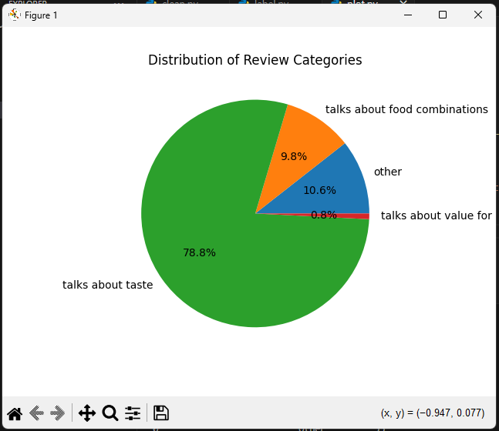
Sentiment Analysis Process
Used libraries,
pandas
NLTK
transformers
tqdm
matplotlib
For better code management and separation of concerns we divided this task into main 3 subtasks.
clean.py – Clean the dataset. Output the cleaned dataset.
label.py – Use the ML model to label each review into given categories. Output labelled reviews.
plot.py – plot the chart using the labelled data.
Since the model take nearly 1 hour to finished the classification process we used ‘tqdm’, a library we can use with pandas to show a loading bar while it executes the ‘apply’ method of pandas.
Additionally, we can do a supervised multi-label learning process to fine-tune the model.
Those file are in the ‘extra’ folder.

Slide 5
Dashboard Insights
Interactive dashboard built with python using the Plotly dash and Pandas libraries.
Additionally we had to import NumPy for some functions in Plotly.
Dashboard stylings was added to a separate CSS file to separate logic and styles in the code as a best practice.
A description was added below each chart for better understanding.

Slide 6
Key Takeaways and Next Steps
Key takeaways:
Average price vs Ratings chart shows moderate positive linear correlation. In general, as the price of wine increases, ratings has also increased.
According to rating vs alcohol content chart, alcohol content doesn’t directly influence the rating of the wine.
Next Steps :
Train the model using a subset of data using a supervised multi-label learning method.
Take 100 reviews and clean them.
Manually label them into categories.
Create a pipeline from transformers library to train the model using this subset and fine tune the model.

